Slide 1
Life Stages of Maternal and Child Healthcare in Sierra Leone Biomedical Analytics B585 - Group 5 Project
Meghana Darla, Ramya Keerthi Majji, Puja Darshana Mishra, Robert Quick, Keerthika Sunchu, April Taylor & Pallavi Telu​
Notes:
Hello and welcome to Group 5's presentation on the life stages of maternal and child healthcare in Sierra Leone. I will preface this presentation by saying all observations and interpretations are done as external data consumers and do not reflect the social determinants of healthcare. Thus the insights produced lack the cultural, socioeconomic, and enviornmental context necessary for realworld decision making.

Slide 2

Section 1: Introduction
Exploring Reproductive Health Trends
Describe the trends of Reporting rates for the Reproductive Health dataset by all the districts in Sierra Leone for all the months in 2023. Can you describe the four components of this time series? Using an appropriate time series modeling approach, identify challenges and opportunities in this reporting rate data.
Along with topic and sentiment analysis.
Question 2 and 9
Notes:
We will begin by describing the trends in reporting rates for reproductive health throughout Sierra Leone in 2023 along with the challenges and opportunities in this data.

Slide 3
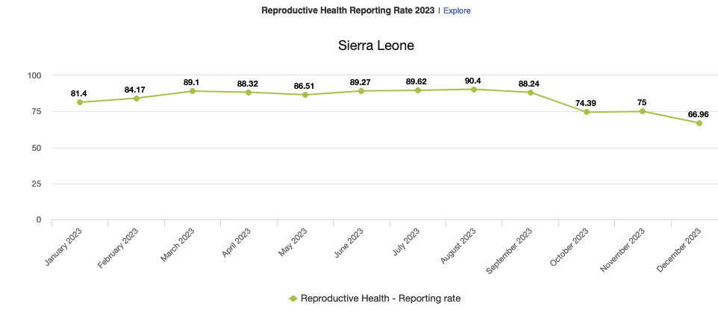
Question 2 Describe the trends of reporting rates for the Reproductive Health dataset by all the districts in Sierra Leone for all the months in 2023. Describe the four components of this time series.
Notes:
The 2023 Reproductive Health Reporting Rates show consistent reporting of over 80% between January and September, then a sharp dropoff at the end of the year. We ran an analysis looking for the 4 aspects of seasonality which includes trend (growth or decline over time), seasonality (swings in data over an intermediate timeframe, in this case Annually), cyclic (very long-term trends), and random variations (unpredictable fluxuations with no discernable pattern). The dataset included only result during two years 2023 and 2024 limiting our ability to do long-term analysis of reporting rates.

Slide 4
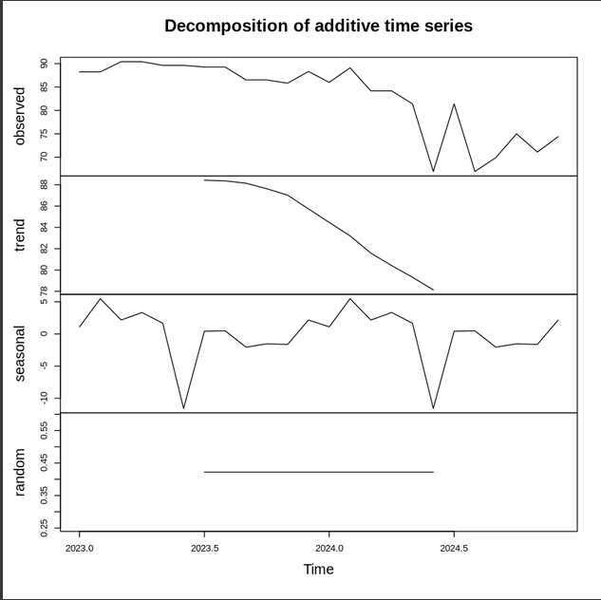
Components of this Series
Trend – There appears to be a slight downward trend over the life of the data.
Seasonality – While the statistical tests show no seasonality (due to short duration of data). The decomposition shows there may be annual seasonality
Cycles – With only 2 years of data available (24 points) it is difficult to determine the long-term swings.
Random – There is no sign of random variations.
Notes:
We analyzed all of the available data (2023 and 2024). There does seem to be a downward trend over the life of the available data, additionally a seasonality pattern begins to appear by doing a decomposition in R, however, with only two years of data it is hard to predict if this pattern is consistent and will continue. Long term or cyclic patterns can not be determined due to the short window of available data, and there appears to be no discernable random variation.

Slide 5
Question 2 Using an appropriate time series modeling approach, identify challenges and opportunities in the reporting rates for the Reproductive Health dataset by all the districts in Sierra Leone for all the months in 2023.
Friedman, Kruskall-Wallis, F-test on seasonal summaries, and Welch test all return False for seasonality.
Reporting does appear to go down during the months of October, November, and December.
This does not appear to be weather related as October is the peak of the rainy season, but November and December are mostly dry and pleasant.
The overall downtrend in reporting between 2023 and 2024 should cause concern for local health officials.
Incentivizing reporting may be one way to increase reporting rates.
Making reporting easier (more places to report and less administrative hurdles) may also help increase reporting rates.
Notes:
Using R to do seasonality testing, the Friedman, KW, F-Test, and Welch test all returned FALSE for their respective tests. While Friedman was the most appropriate test, we completed the full suite of tests for completeness.
As seen in the decomposition graph on the previous slide, there does appear to be some seasonality with a dropoff in reporting during October-December, this does not coincide with weather patterns.
There does seem to be some drop in reporting rates during 2024 (which do not appear on the graph), this general downtrend is worth more exploration.
Incentivizing reporting and lowering barriers are two possible strategies to increase reporting rates.

Slide 6
Topic Analysis—Reproductive Health
Interactive Topic Map
Coherence Score for the final model (9 topics): 0.4118 (low interpretability)
Topic 1 | Topic 2 | Topic 3 | Topic 4 | Topic 5 | Topic 6 | Topic 7 | Topic 8 | Topic 9
reporting | reporting | reporting | reporting | reporting | seasonality | data | reporting | reporting
rates | data | rates | data | data | data | reporting | data | rates
data | rates | health | 2023 | 2024 | years | resource | rates | year
trend | health | data | rates | 2023 | 2023 | rates | decline | decline
2023 | trend | districts | year | years | November | year | health | monthly
year | seasonal | like | months | significant | reporting | patterns | collection | highlights
health | year | year | decline | patterns | months | health | trend | Leone
decline | analysis | reproductive | seasonality | However | rates | decline | year | quarter
could | like | might | seasonal | rates | December | collection | Leone | sharp
seasonality | time | Leone | years | steady | decline | gaps | system | Sierra

Slide 7
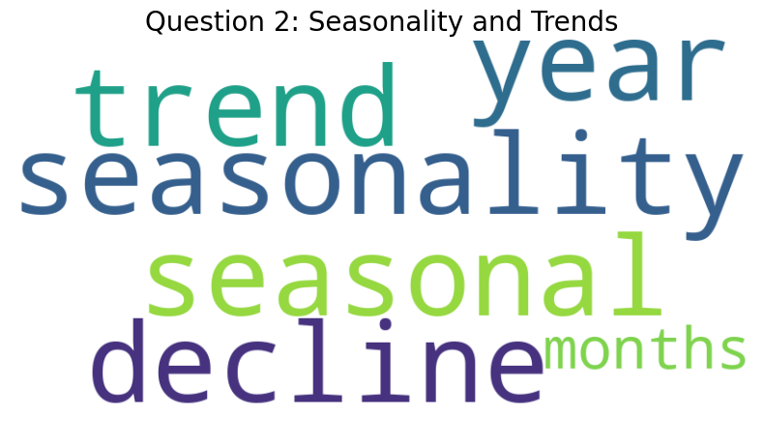




Slide 8
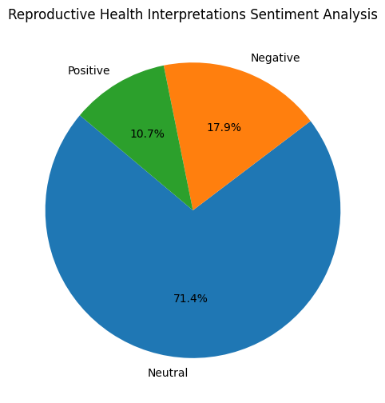
Sentiment Analysis—Reproductive Health

Slide 9

Section 2:
Antenatal care and Pregnancies
Compare the facilities on Sherbro Island on how they do on -ANC 3 Coverage, and PHU delivery rate. Please select the appropriate visualization to represent this comparison.
Along with topic and sentiment analysis.
Question 8 and 9

Slide 10
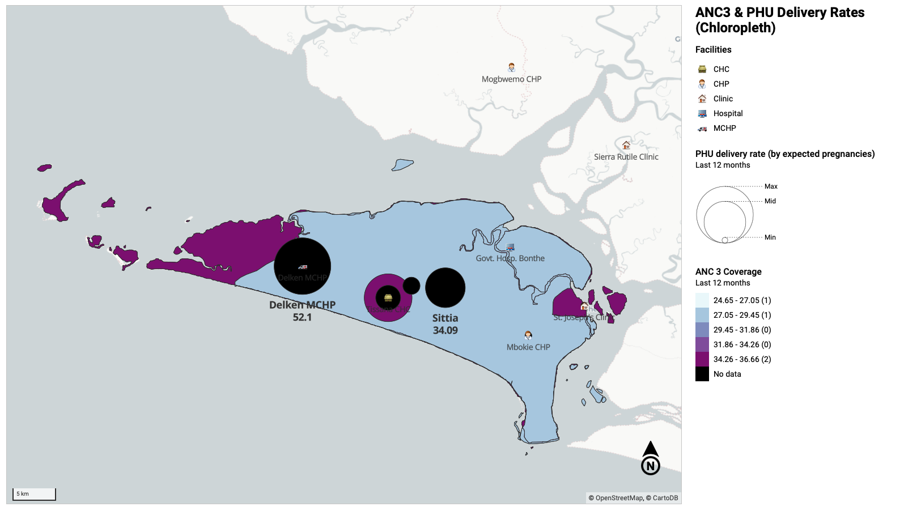
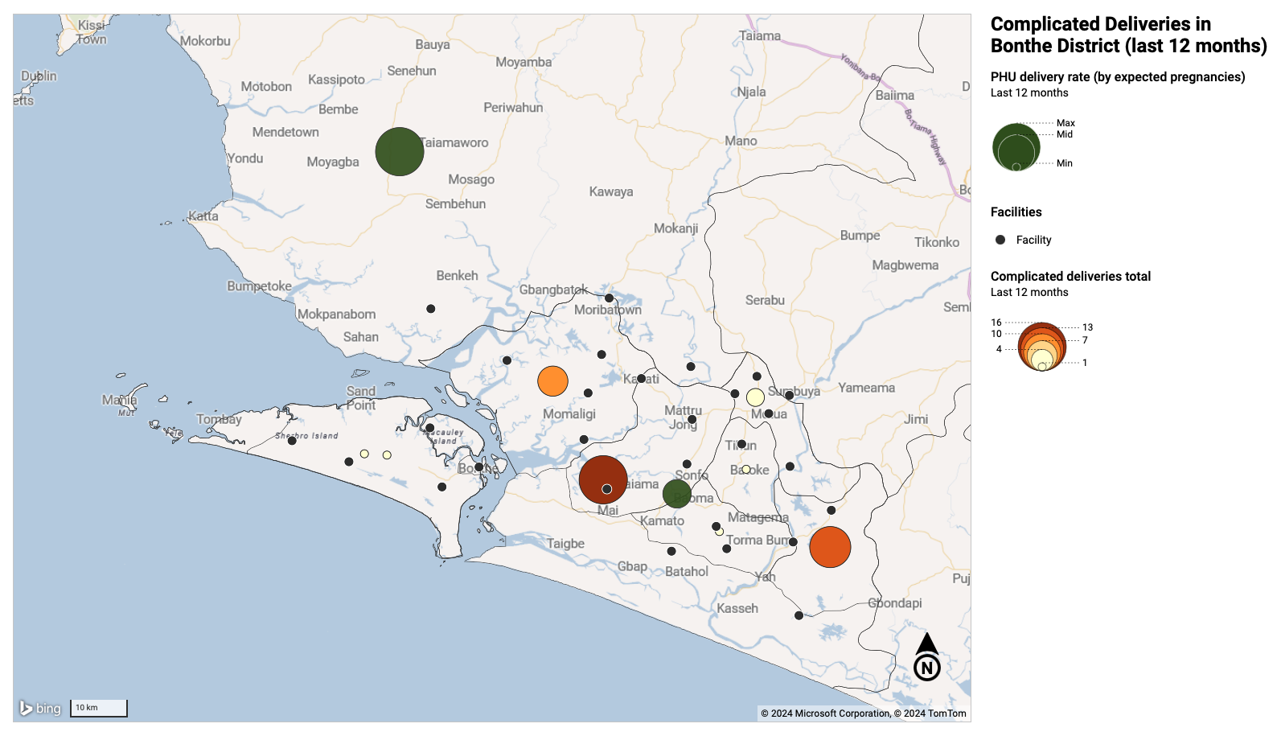
Antenatal Care (3 visits) and Peripheral Health Unit Delivery Rate
Higher ANC3 Coverage: Tissana CHP and St. Joseph’s Clinic (purple areas); likely due to better accessibility and infrastructure.
Tissana CHP: Moderate delivery rate.
Delken MCHP: Highest delivery rate (52.1%) despite no ANC3 coverage.
St. Joseph’s Clinic and Mbokie CHP: No delivery rates, signaling infrastructure gaps.
Bonthe Hospital Challenges: No ANC3 coverage or delivery rates, likely due to isolation or resource limitations.
Comparison of Delivery Rates and Complicated Deliveries to Entire District
Delivery rate lower on the island, but fewer complicated deliveries.
Suggests high-risk pregnancies are managed on the mainland.

Slide 11
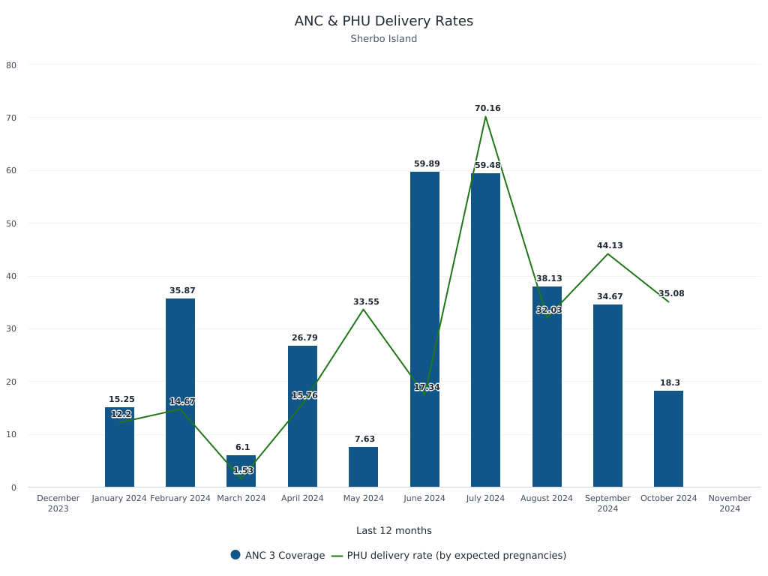
12-Month Overview: Displays ANC-3 coverage and PHU delivery rates on Sherbro Island. Highest Rates: Both ANC-3 coverage (59.89%) and delivery rates (70.16%) peak in July 2024, hinting at a potential correlation. Lowest Rates: May 2024 shows significant drops in ANC-3 coverage (7.63%) and delivery rates (17.84%), highlighting potential service gaps Key Insight: Overall low rates suggest many maternal healthcare services are accessed off the island.

Slide 12
Topic Analysis—Antenatal Care & Delivery Rates
Coherence Score for the final model (4 topics): 0.5332 (high interpretability)
Interactive Topic Map
Topic 1 | Topic 2 | Topic 3 | Topic 4
ANC | delivery | delivery | coverage
delivery | PHU | PHU | delivery
health | facilities | ANC | PHU
PHU | rates | care | ANC
care | coverage | coverage | ANC3
women | care | rates | Island
transportation | services | services | facilities
could | deliveries | facilities | rates
deliveries | Island | antenatal | care
maternal | ANC | maternal | rate

Slide 13


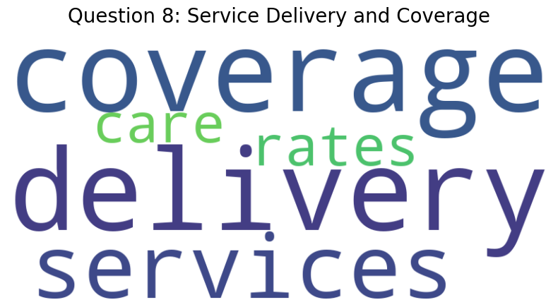


Slide 14
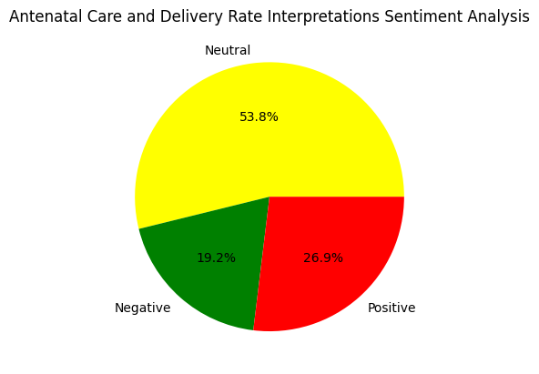
Sentiment Analysis—Antenatal Care & Delivery Rate

Slide 15

Section 3:
Inter-dataset Reporting Comparisons
Among the following datasets, which of the reporting rates are the closest across the last 12 months for all of Sierra Leone, and provide a line chart comparison of these
Reproductive Health
Child Health
PMTCT monthly summary
Question 3
Notes:
Building on the trends observed in Reproductive Health and antenatal care coverage, we now turn to Q3, where we compare reporting rates for Reproductive Health, Child Health, and PMTCT monthly summaries.

Slide 16
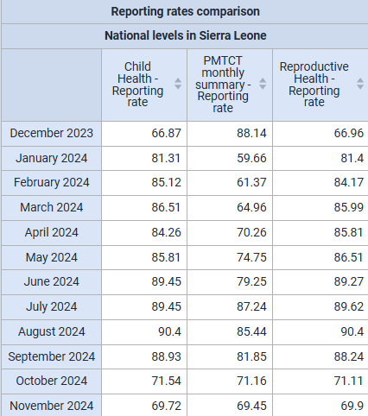
The pivot table shows the reporting rates for Child Health, PMTCT monthly summary (Prevention of Mother-to-Child Transmission), and Reproductive Health at the national level in Sierra Leone over the past 12 months (between December 2023 and November 2024).

Slide 17
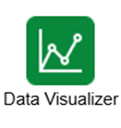
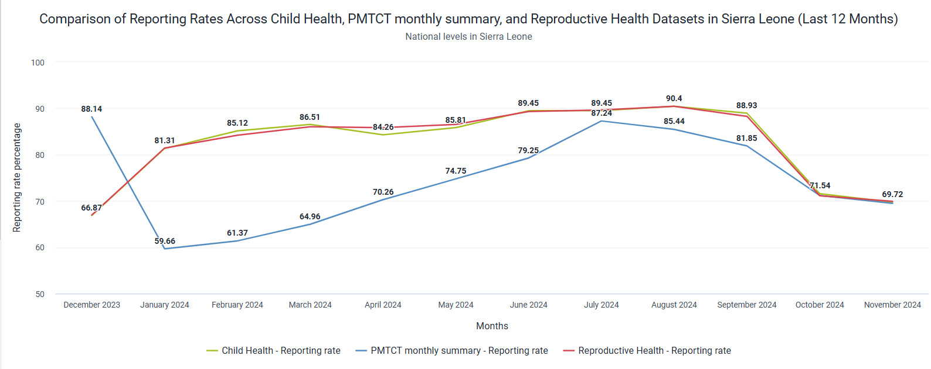
Reproductive Health and Child Health reporting rates are consistently closest.
PMTCT reporting rates show variability, especially in the first half of the year.
By October–November 2024, all three datasets converge, indicating improved alignment.
Notes:
This line graph compares the reporting rates for Reproductive Health, Child Health, and PMTCT monthly summaries over the last 12 months, offering insights into alignment and variability across these datasets. Reproductive Health and Child Health rates are closely aligned throughout much of the year, particularly from March to August 2024, with minimal differences, such as 1.55% in April 2024. This reflects strong integration between maternal and child health services, ensuring consistent care delivery for mothers and infants. In contrast, PMTCT reporting rates exhibit significant variability early in the year, diverging from the other two datasets. For example, in January 2024, PMTCT reporting was only 59.66%, compared to 81.31% for Reproductive Health and 85.12% for Child Health. This variability highlights challenges in linking maternal care with HIV prevention efforts, signaling the need for improved coordination and resource allocation. By October and November 2024, all three datasets converge, with PMTCT reaching 69.45%, closely aligned with Reproductive Health (69.9%) and Child Health (69.72%). This convergence indicates progress in reporting alignment and integration, emphasizing the critical role of maternal care in preventing mother-to-child HIV transmission and safeguarding infant health.

Slide 18
Interpretation:
Reproductive health and Child health rates: Closest alignment throughout the year reflects strong maternal-child health integration.
PMTCT variability: Divergence in early months points to gaps in linking maternal care and HIV prevention efforts.
End-of-year convergence: Suggests progress in aligning reporting mechanisms across programs.

Slide 19

Section 4:
Vaccination Coverage
For the last 12 months, which chiefdoms of Sierra Leone have a high OPV1 coverage for kids less than 1 year old.
Compare the facilities in the geographical region of Sherbro Island and its surrounding coastal region for OPV1 coverage <1 yr.
Describe the type of facilities in the geographical region of Sherbro Island that has the highest OPV1 coverage and the lowest OPV1 coverage <1yr
Question 5, 6, 7

Slide 20
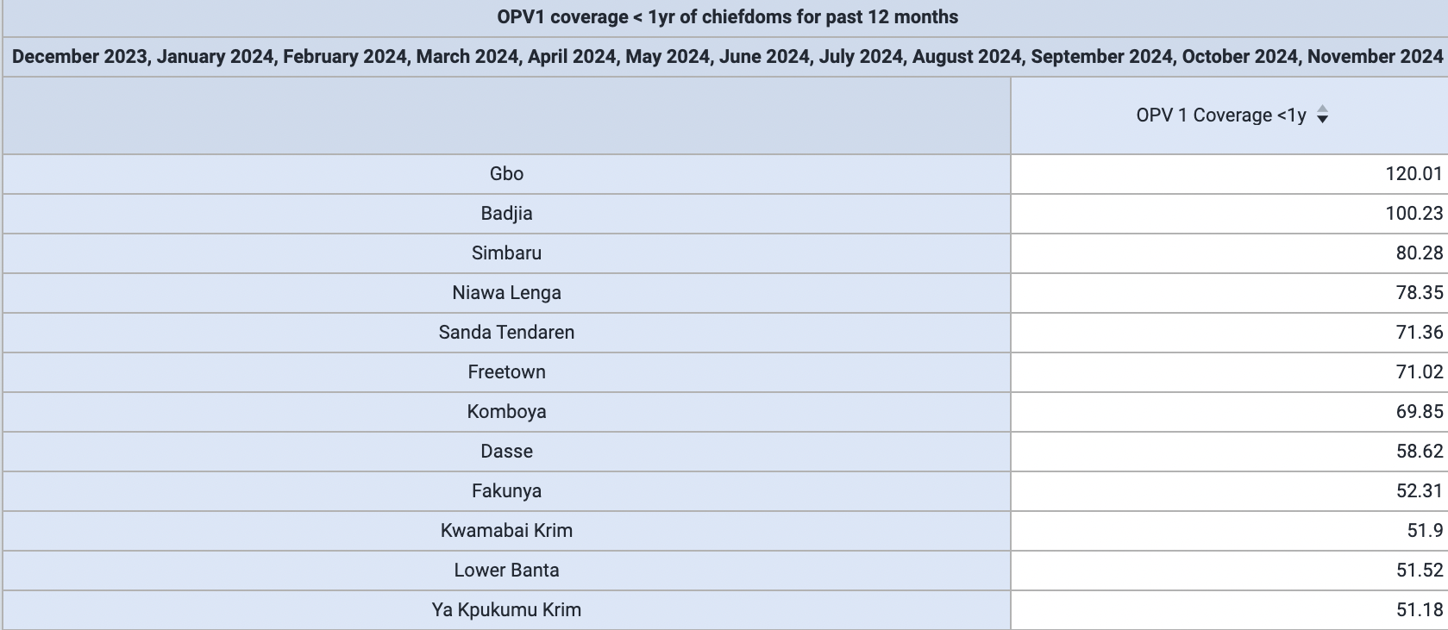
Created a Pivot table to show the chiefdoms with highest OPV 1 coverage

Slide 21
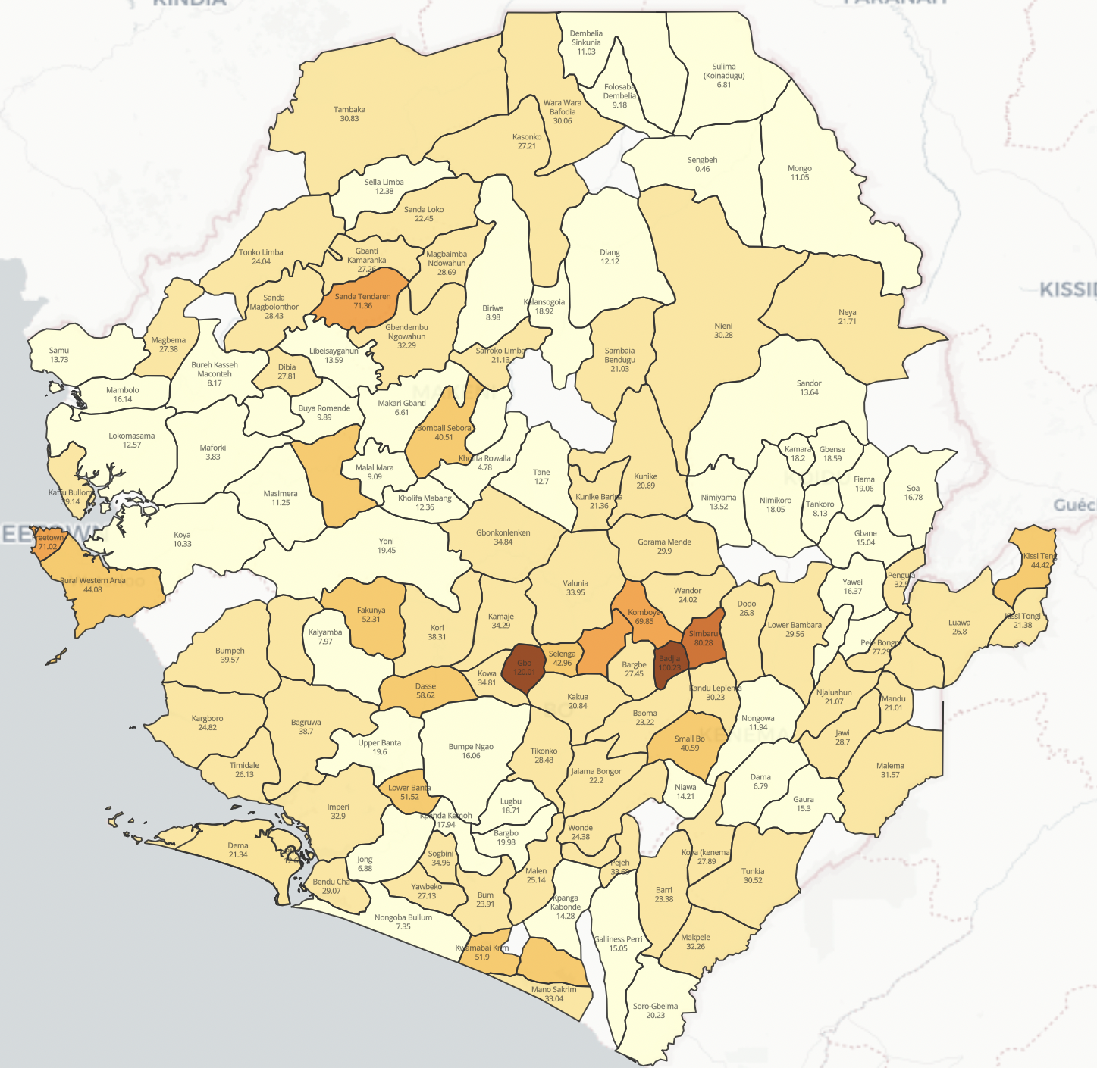
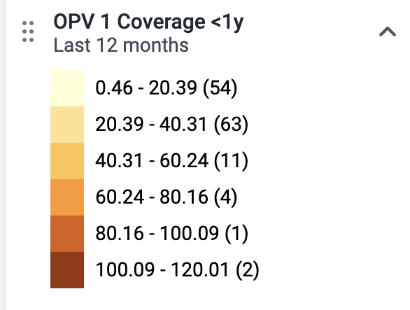

Slide 22
Interpretation:
Top Performing Chiefdoms:
Simbaru: Highest OPV1 coverage at 80.28%.
Niawa Lenga: Second highest OPV1 coverage at 78.35%.
Gbo and Badija Chiefdom:
Has the highest reported OPV1 coverage with a value of 120% and 100.23%, which is invalid as percentages above 100 are not possible.
This value indicates a possible data entry error.
Importance of a Choropleth Map:
Geographic Insights: Highlights regional trends and chiefdom performance at a glance.
Clear Flagging: Invalid values like Gbo and Badija are visually distinguished, aiding in error detection.
Pivot Table :
Provides a detailed breakdown of chiefdoms and their exact OPV1 coverage values.
Ensures precise data interpretation alongside the geographic visualization.

Slide 23
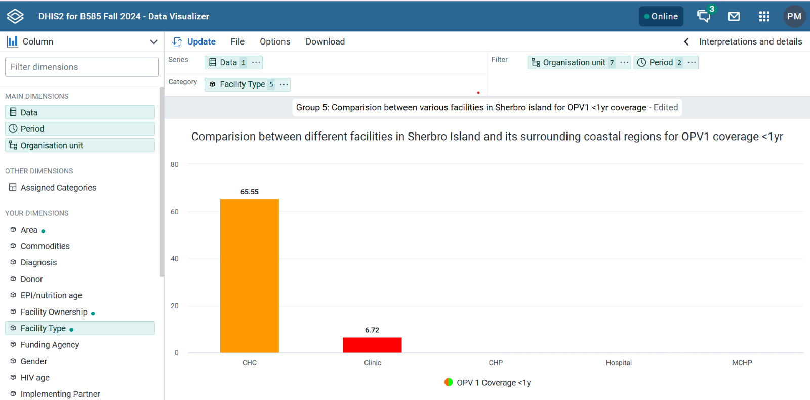
Question 6 Compare the facilities in the geographical region of Sherbro Island and its surrounding coastal region for OPV1 coverage <1 yr.
The geographical region of Sherbro Island and its surrounding coastal region are formed by the Sittia, Nongobabullum, Dema, Benducha and Imperi. The facilities in this region where OPV1 coverage was seen are majorly the CHCs and one clinic. All the other facilities do not have any contribution to OPV1 <1yr comparison.
The bar chart below shows the comparison between various facilities in the OPV 1 coverage <1 yr in the geographical region of Sherbro Island and its surrounding coastal region:

Slide 24
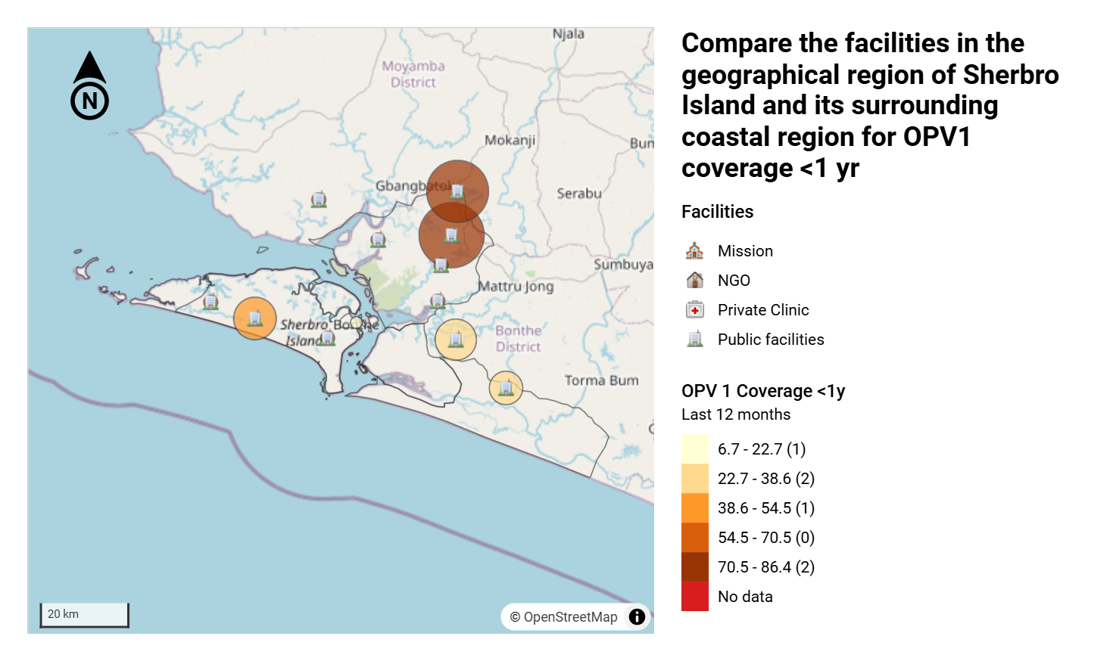
The facilities in this region where OPV1 coverage was seen, were all public facilities , this shows the need for fund allocation for development of health infrastructure in this area.

Slide 25
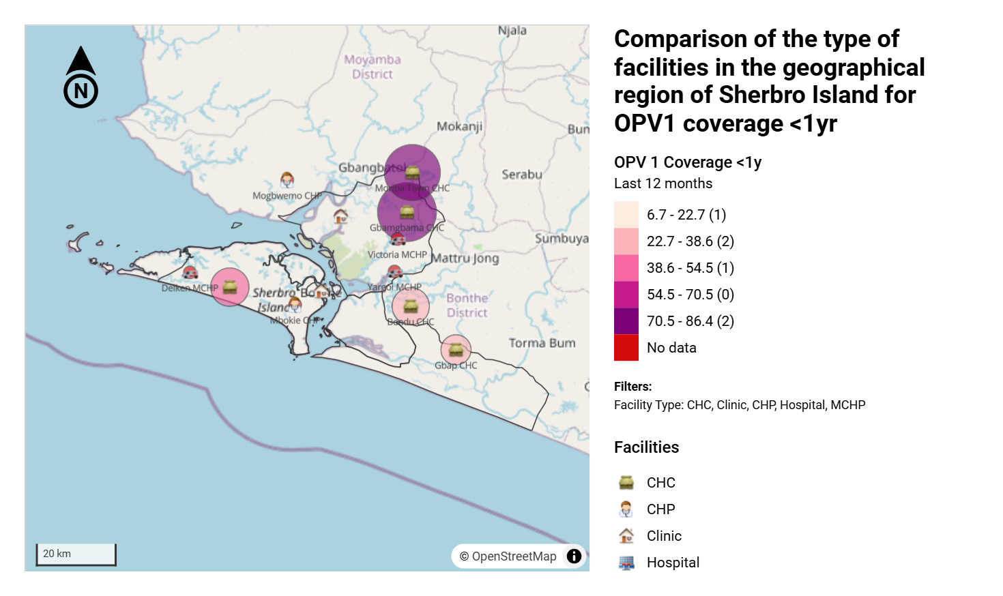
Question 7 Describe the type of facilities in the geographical region of Sherbro Island that has the highest OPV1 coverage and the lowest OPV1 coverage <1yr
The highest coverage for OPV1 is seen in GbamGbama CHC with a coverage of 79. 29 in the region and lowest is seen in St. Joseph clinic at 6.71.

Slide 26
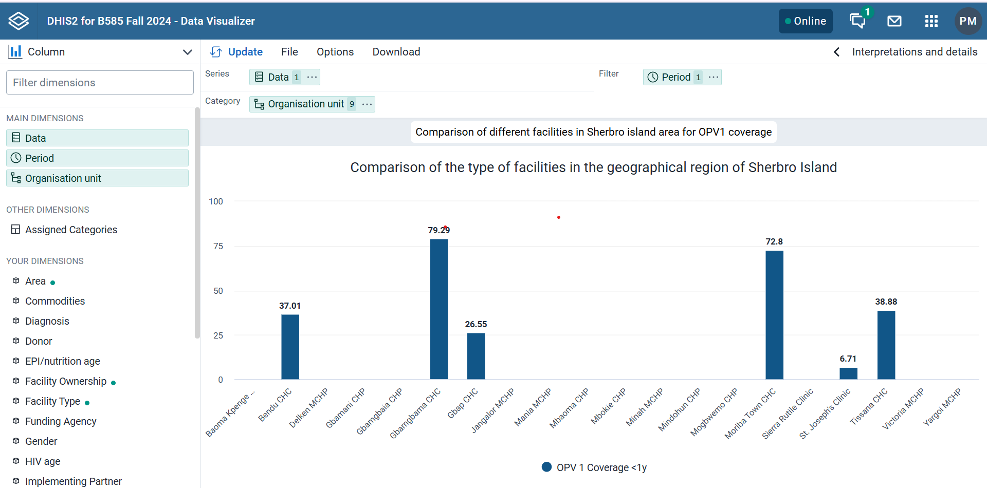

Slide 27

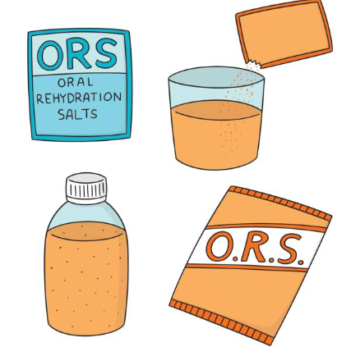
Section 5: Childhood Illnesses & Intervention
Describe the underlying data elements, categories, and category combinations by which you calculate the "Diarrhea <5 y incidence rate". Create a table that gives underlying data values for every district, along with the indicator value for the last 12 months.
Can you predict the minimum stock for Oral Rehydration Solution (ORS) that should be maintained in the district with the highest average rate of diarrhea < 5y if we know that these children need to be given 3 packets each day for 5-14 days of an episode. (Question 4b)
Question 4a & 4b

Slide 28
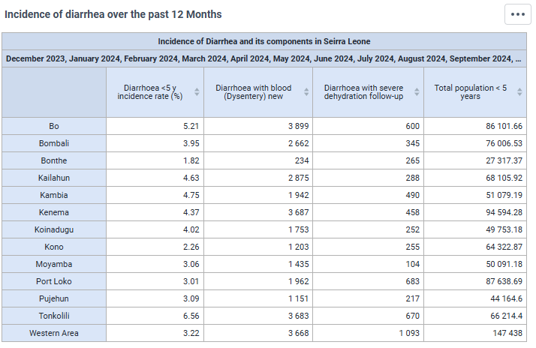

Here, we are working with the Indicator "Diarrhea <5 yr incidence rate", we went into the meta data to check what data elements this indicator is composed of-
Data Elements:
Diarrhea with blood (Dysentry) new: New cases of diarrhea with blood (dysentery) in children <5 years. It is the highest in Western Area (3,668), lowest in Bonthe (234).
Diarrhea with severe dehydration follow-up: Cases of severe dehydration due to diarrhea requiring follow-up care. These cases are the highest in Western Area (1,093), lowest in Pujehun (217).
Total population <5 years: Total number of children under 5 in each district. The districts where the population of children <5 years is highest in Western Area (147,438) & lowest in Pujehun (44,164).
Categories:
This indicator categorizes data by age (<5 years), severity (e.g., dysentery, severe dehydration), and case type (new, follow-up, referral) to track critical diarrhea cases.
Category Combinations: The category combination for both the numerator values is Morbidity cases, which means the total count of individuals experiencing illness or disease within a specified population, the illness here being Diarrhea.
This pivot table shows the incidence rate of diarrhea in children under 5 across districts, highlighting that districts with the highest number of diarrhea cases (e.g., Western Area) may not necessarily have the highest incidence rate, as this depends on the total population of children under 5 in each district.
The higest incidence rate was in the district of Tonkolli with an incidence of 6.56 and the lowest is in Bonthe with 1.82
Question 4a & 4b

Slide 29
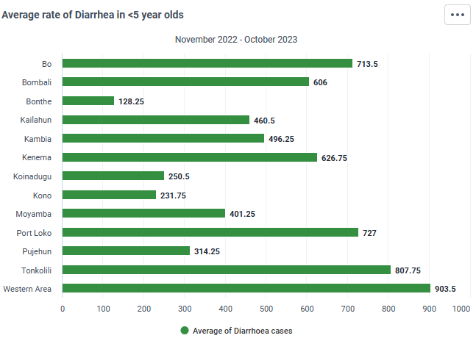
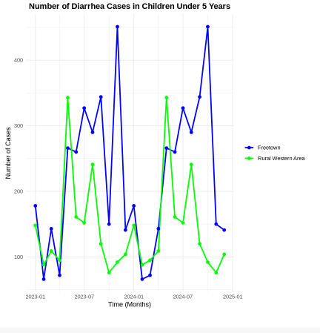
We approached the 2nd problem of calculating the ORS stock this way-
Identify Data Elements: Narrow down data elements contributing to the average.
Find District with Highest Average Cases: Locate the district with the highest average diarrhea cases.
Analyze 2-Year Data: Extract 2-year data from chiefdoms in the identified district.
Forecast in R: Import data into R and forecast cases for the next year.
Calculate ORS Stock: Determine minimum ORS stock needed for 5 days
Data elements which we selected for average are- New diarrhea cases with blood (dysentery) and severe dehydration in children under 5 years were chosen, as all cases, including referrals, require ORS as the first line of treatment. The district with highest average diarrhea cases was Western Area, as shown in the bar chart here.
We took the last 24 months data of Chiefdoms Freetown & Western area to colab, which both had no missing values or many outliers to do a forecast for next year case count.
We divided the dataset into training (first 18 months) and testing set (last 6 months) and performed forecasting methods like Auto-ARIMA, ETS, SES Holt Winters, and used MAPE to calcuate the efficiency of the model.
Colab link- https://colab.research.google.com/drive/1uJU6T-kG4uvTIa2_JSfj83I0s9Pzxug1?usp=sharing

Slide 30
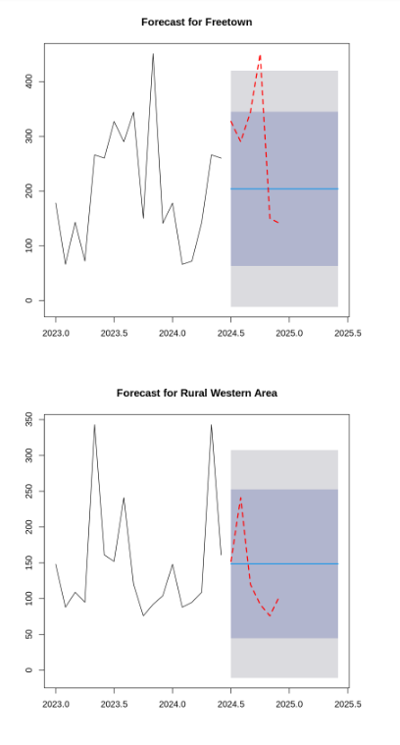
Results of the Forecasting process-
Auto- Arima was the better performing model for our data out of all the models we tried, we got a MAPE value of 40.57123 % and 44.0051 % for Rural Western Area, which is reasonable, but not the best or good.
Some of the reasons why we think our forecasting was not optimum was- irregular peaks in the data, non-stationarity and inconsistent seasonal trends across the two years of data.
Based on forecasted diarrhea cases for the next year, we calculated the minimum stock required for 5 days, prescribing 3 ORS packets per day. This resulted in 36,730 packets for Freetown and 26,730 packets for the Rural Western Area, leading to a total of 63,460 packets for the Western Area District.
Why Chiefdom-Level Calculation is Enough?
Facilities within these chiefdoms are located 20–30 km apart, ensuring feasible transportation during dire conditions.

Slide 31


Section 6: Referral trends and Forecasting
Questions we are answering-
Compare the two health facilities of Bo district - Ngelehun CHC in Badija and Jembe CHC in Baoma on the following: number of patients who have been referred and the cause of the referral for those who have been referred for the last 12 months. Also, could you identify the patient characteristics of those referred from these facilities compared to those not referred?
Can you build a model to predict the number of patients referred in each month of next year from these facilities? Please discuss some considerations when doing predictive modeling for this?
Question 1a & 1b
Notes:
I will compare two health facilities in Bo District: Ngelehun CHC in Badija and Jembe CHC in Baoma.

Slide 32
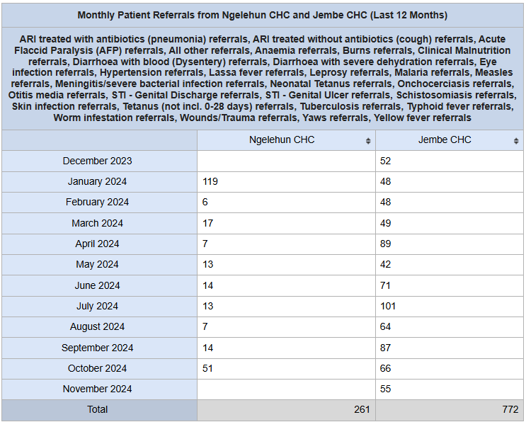
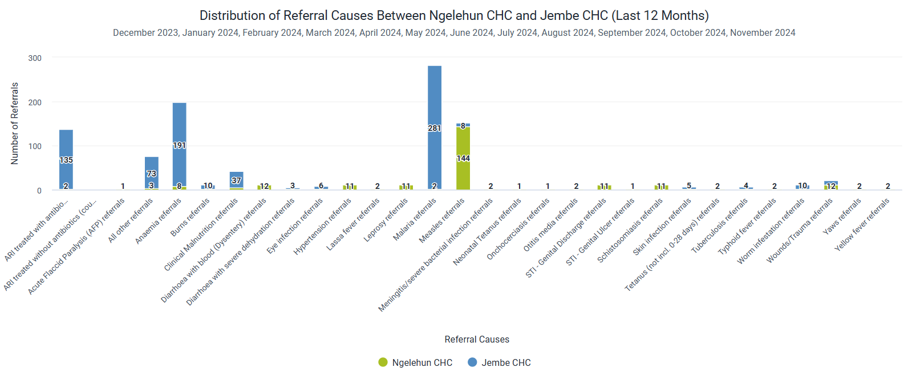
Comparison of Patient Referrals from Ngelehun CHC and Jembe CHC (Last 12 Months)
Comparison of Cause of Referrals at Ngelehun CHC and Jembe CHC (Last 12 Months)
Jembe CHC: High referrals for malaria (281 cases), anaemia (191 cases), and pneumonia (135 cases). Referrals for diverse conditions like clinical malnutrition and acute flaccid paralysis suggest a broader healthcare burden.
Ngelehun CHC: Higher referrals for measles (144 cases) and dysentery (12 cases). Indicates possible outbreaks or a specific disease burden in the catchment area.
Limitation: Missing data observed for some months at Ngelehun CHC, impacting direct comparisons.
Interpretation: Over the last 12 months, Jembe CHC referred had 772 referrals, significantly more than Ngelehun CHC's 261 referrals.
Notes:
Comparison of Referrals Over the last 12 months, Jembe CHC referred 772 patients, significantly more than Ngelehun’s 261. Jembe consistently referred 48–101 patients monthly, while Ngelehun showed lower, inconsistent referral numbers, partly due to missing data.
Causes of Referrals At Jembe CHC, the main causes of referrals were malaria (281 cases), anemia (191 cases), and pneumonia (135 cases), reflecting a high burden of these conditions. At Ngelehun CHC, referrals were more focused on measles (144 cases) and dysentery (12 cases), indicating localized outbreaks or specific disease burdens.

Slide 33
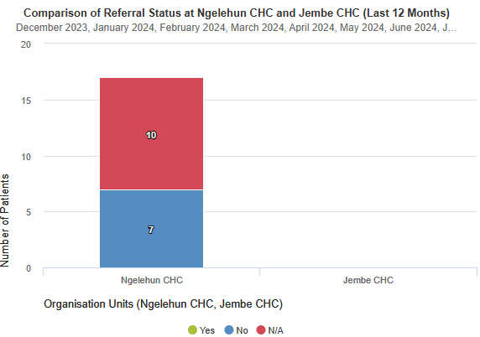
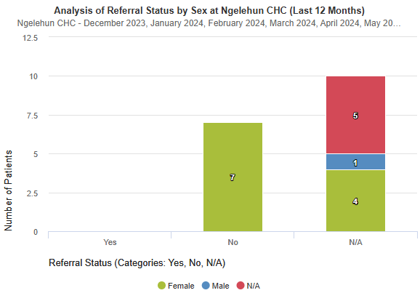
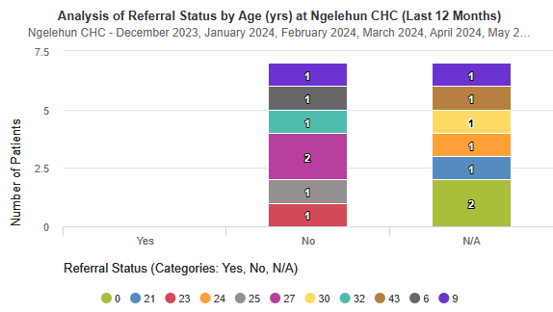
Patient Characteristics and Referral Patterns at Ngelehun CHC and Jembe CHC (Last 12 Months)
Interpretation:
The stacked column chart shows that the majority of patient records from Ngelehun CHC had missing referral status marked as "N/A" (10 cases), followed by "No" referrals (7 cases). No "Yes" referrals were recorded for this period. Data from Jembe CHC is absent, preventing comparative analysis.
At Ngelehun CHC, most patients who were not referred are female (7 cases). Among patients with missing referral status ("N/A"), there is a mix of female (4 cases), male (1 case), and unspecified sex (5 cases). No patients of any sex were recorded as referred ("Yes") during this period.
At Ngelehun CHC, most age groups have missing referral status marked as "N/A". Among the "No" referrals, patients are distributed across a range of ages, but no referrals ("Yes") are observed.
Notes:
Patient Characteristics and Referral Patterns at Ngelehun CHC and Jembe CHC At Ngelehun CHC, most patients were not referred, and referral status was often marked "N/A" due to missing data. Most patients were female, ranging in age from infants to 43 years, highlighting a focus on pediatric care. Jembe CHC lacked data for comparison.

Slide 34
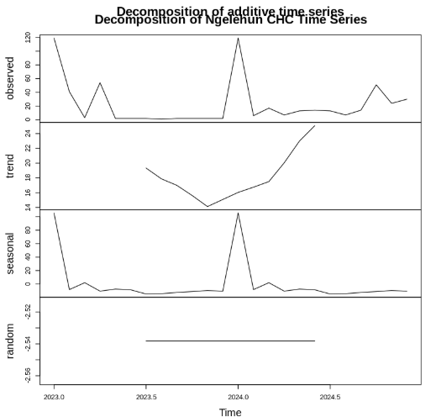
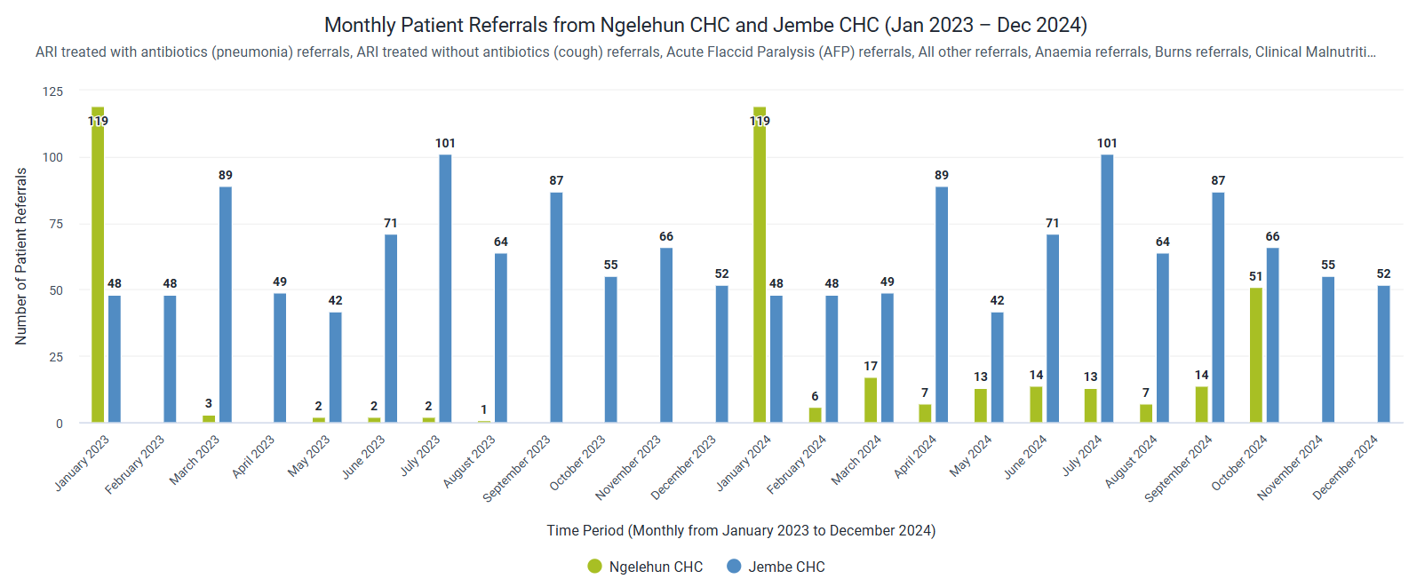
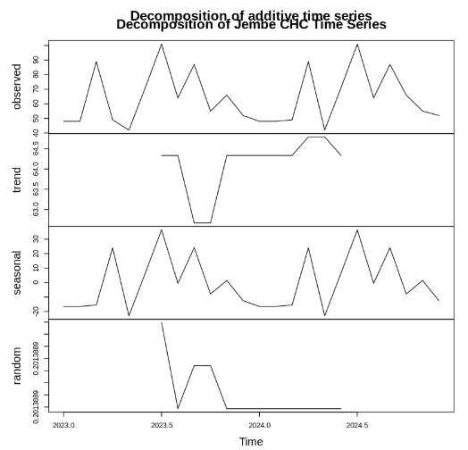
Referral Data From January 2023 To December 2024
(24 Months)
Notes:
To build a model to predict monthly referrals for 2025, I Used the referral data from January 2023 to December 2024.

Slide 35
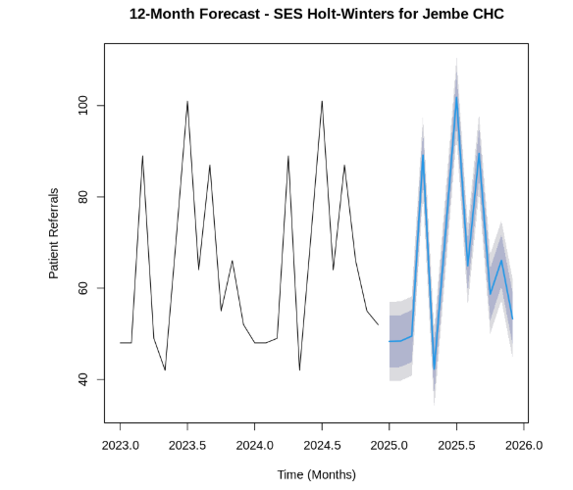
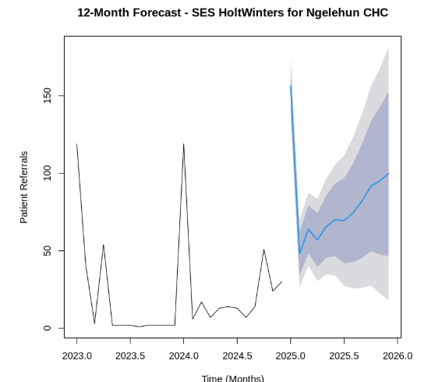
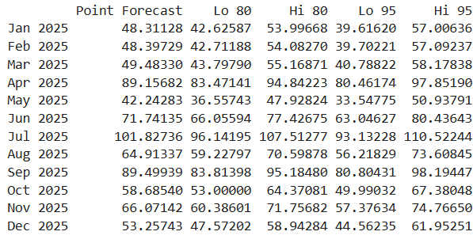
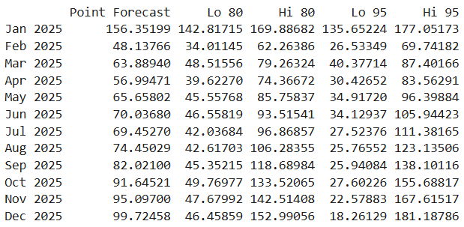
12-Month Referral Forecast for Jembe CHC and Ngelehun CHC (2025)
Considerations When Doing Predictive Modeling
Data Preparation and Modeling Steps:
Monthly referral data (Jan 2023–Dec 2024) from DHIS2.
Missing data handled via 3-period Simple Moving Average (SMA).
Converted to time series, split into training (Jan 2023–Jun 2024) and validation (Jul–Dec 2024).
Identified trends, seasonality, and random components.
Tested Auto ARIMA, ETS, and SES Holt-Winters. Selected SES Holt-Winters for forecasting.
Yes, we were able to build a model to predict the number of patients referred in each month of next year from these facilities.
Data Quality: Addressed missing data using a 3-period Simple Moving Average (SMA).
Feature Engineering: Decomposed time series into trends, seasonality, and random components for better insights.
Model Selection: Tested Auto ARIMA, ETS, and SES Holt-Winters; selected SES Holt-Winters for best performance
Model Evaluation: Assessed using MAPE to ensure models captured seasonal variations effectively.
Seasonality & Trends: SES Holt-Winters modeled seasonality and trends critical for accurate forecasting.
Uncertainty & Confidence: Used 80% and 95% confidence intervals to quantify prediction variability and guide planning.
Jembe CHC - 12-Month Referral Forecast for 2025
Ngelehun CHC - 12-Month Referral Forecast for 2025
Notes:
Then Missing data was addressed with a 3-period moving average, and I tested multiple models—Auto ARIMA, ETS, and SES Holt-Winters. The SES Holt-Winters model was selected for its ability to capture trends and seasonality, achieving a MAPE of 18.38% for Jembe and 45.77% for Ngelehun.
Considerations for Predictive Modeling Key considerations included addressing missing data, decomposing time series into trends and seasonality, testing various models, and including confidence intervals to quantify uncertainty.
Conclusion In summary, Jembe CHC handles a higher volume of severe cases, while Ngelehun CHC faces localized outbreaks and data quality issues. Predictive modeling provides actionable insights for resource allocation, helping both facilities plan effectively for 2025.

Slide 36
Question 10 Dashboard
Create a new dashboard of the visualization, table, report that you have created for answering all the questions in this project.

Slide 37
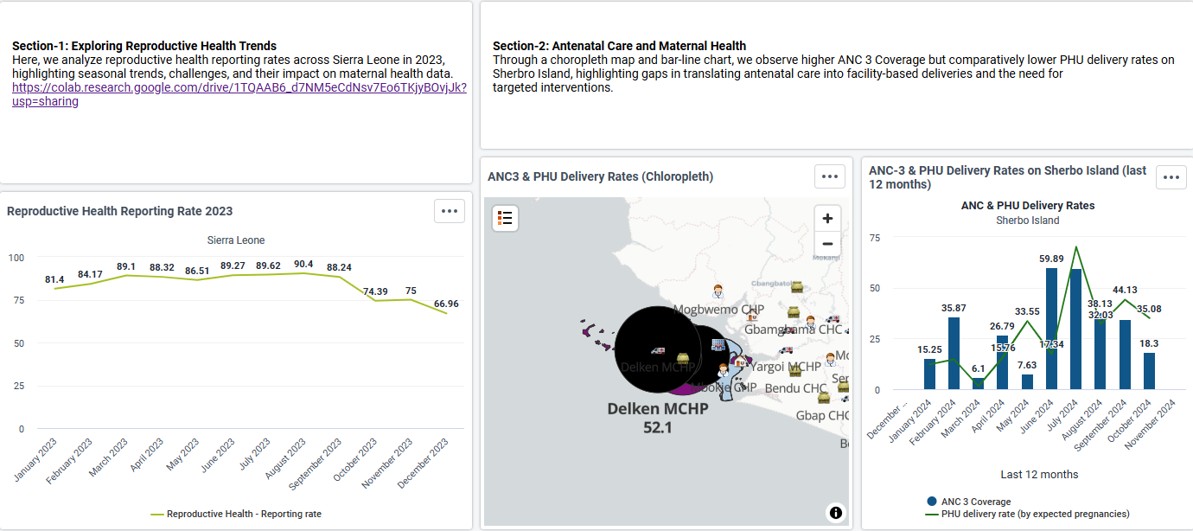

Slide 38
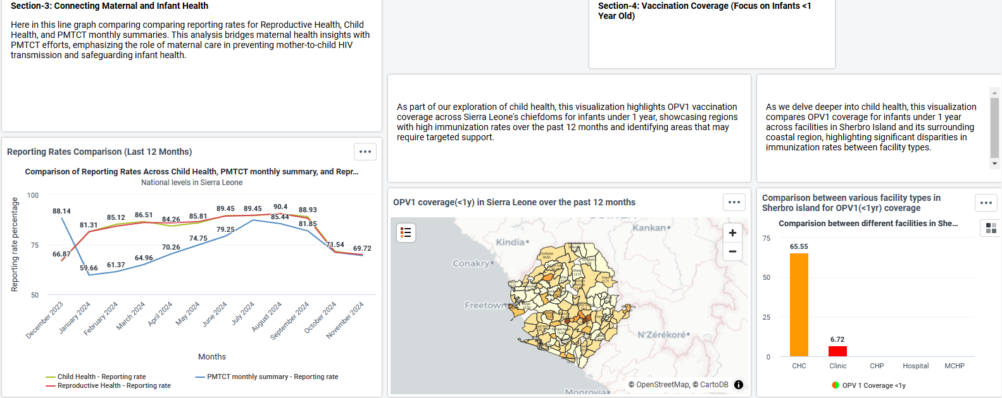
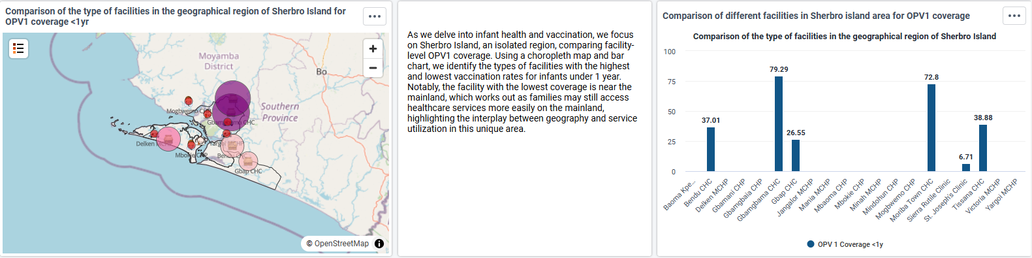

Slide 39
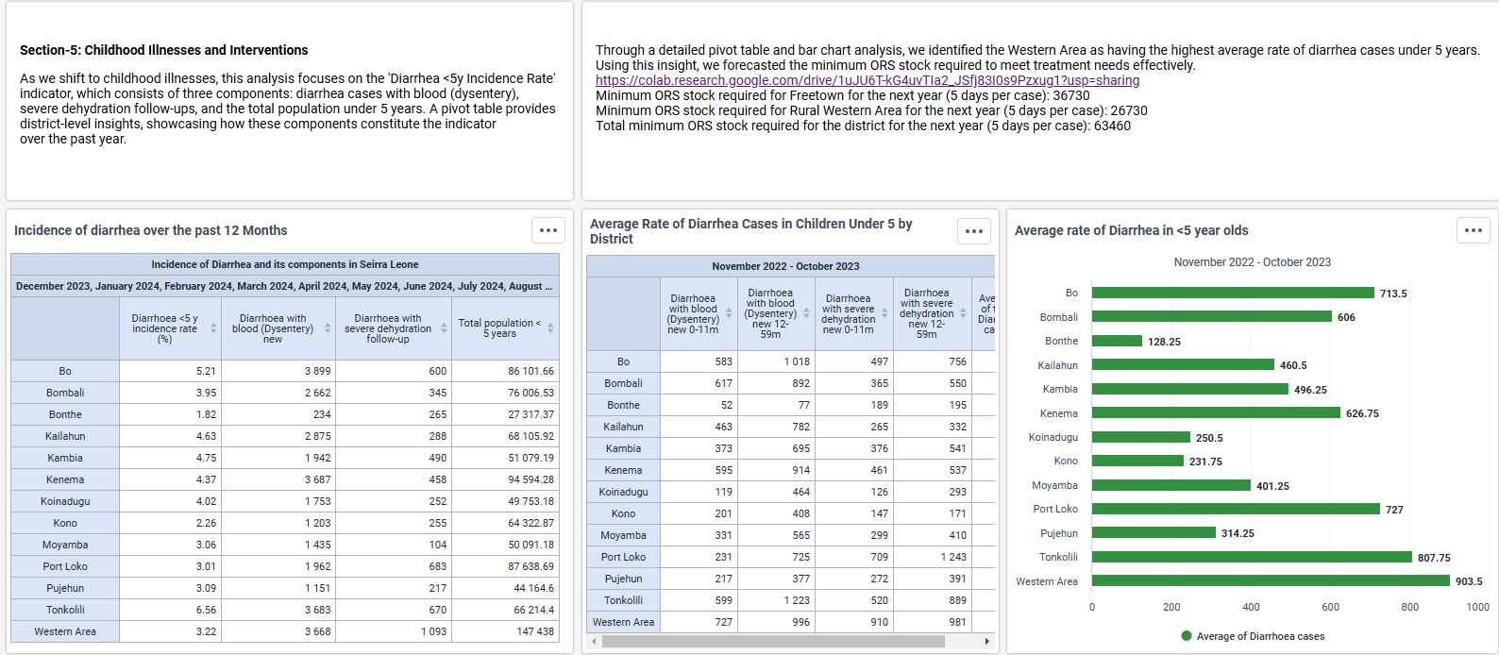

Slide 40
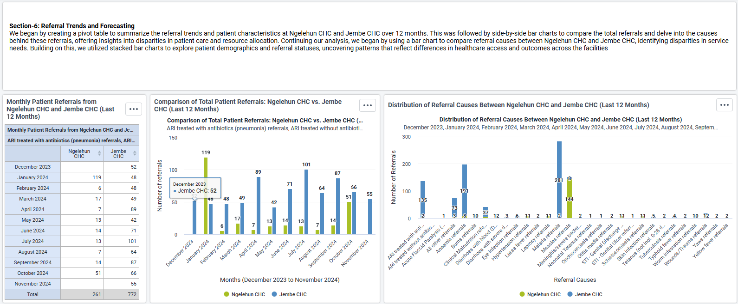

Slide 41
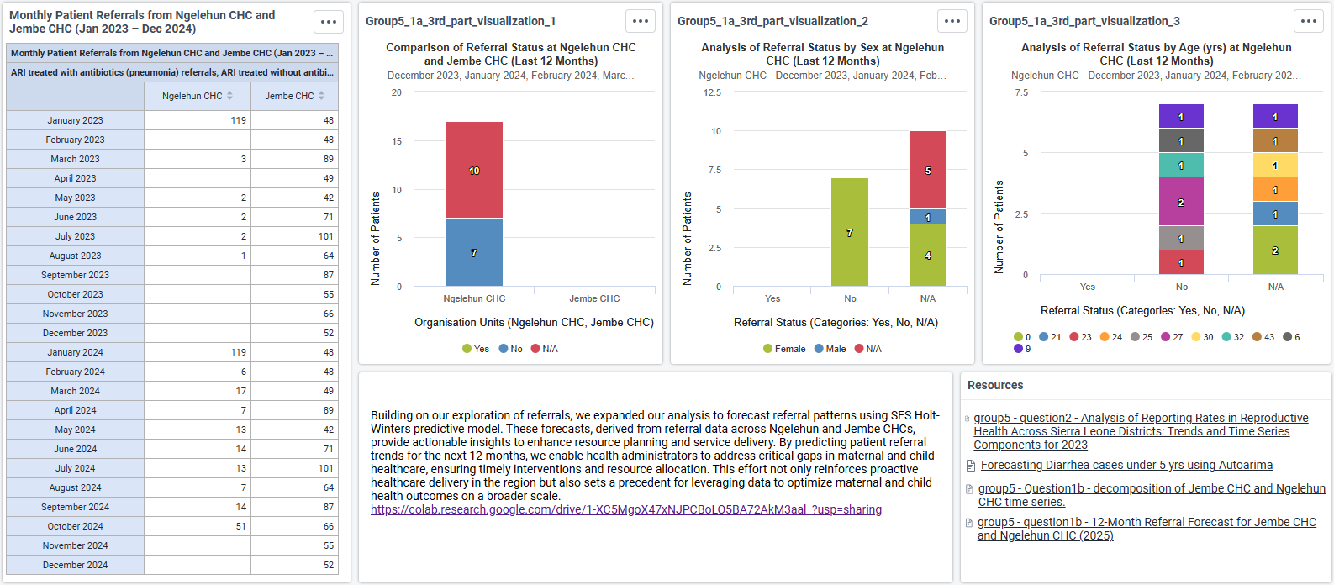
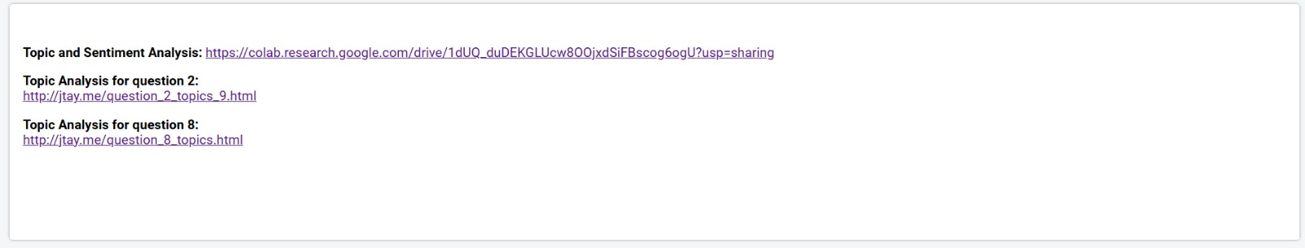

Slide 42
Policy Decisions from Dashboard
The dashboard provides clear insights to guide health policy decisions. For maternal health, the gap between high ANC-3 coverage and low facility-based delivery rates on Sherbro Island shows a need for policies that promote safe deliveries through better access to services, such as transportation, or to community outreach programs. In child health, disparities in OPVI vaccination rates highlight areas that need targeted immunization campaigns. Referral trends from Ngelehun and Jembe CHCs help allocate resources like staff and supplies more effectively, while forecasting ensures readiness for high-demand periods. Data on diarrhea cases emphasizes the importance of distributing ORS supplies and improving hygiene education. The dashboard provides policymakers with consolidated information to guide them in making healthcare decisions.
Notes:
Supplement current data with additional cultural, socioeconomic, and environmental insights. (social determinants of health)
Vaccination drives in low coverage areas. (incentivize and lower barriers to vaccinations)
Invest in supply distribution and education programs.

Slide 43
APPENDIX

Slide 44
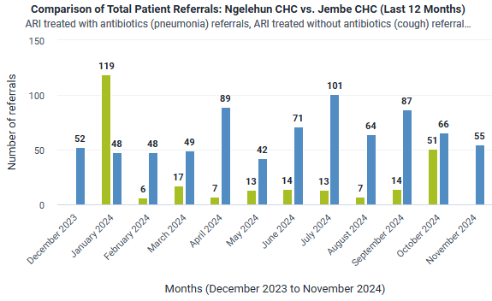
QUESTION 1a
Comparison of Patient Referrals from Ngelehun CHC and Jembe CHC (Last 12 Months)
Data Collection Steps:
Selected Ngelehun CHC and Jembe CHC as the Organization units.
Analyzed data for the last 12 months.
Chose "referrals" as the data element group and visualized it.
Visualization Tools:
Pivot Table format for monthly breakdown.
Column chart for total referrals comparison.
Limitation:
Missing data observed for some months at Ngelehun CHC, impacting direct comparisons.
Interpretation:
Over the last 12 months, Jembe CHC had 772 referrals, significantly more than Ngelehun CHC's 261 referrals.

Slide 45
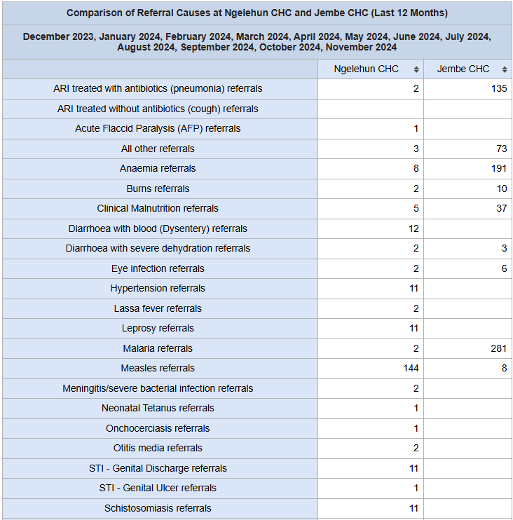
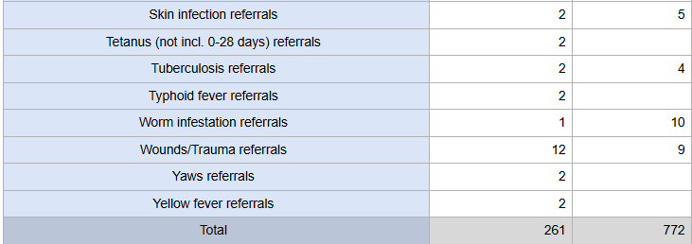
Comparison of Cause of Referrals at Ngelehun CHC and Jembe CHC (Last 12 Months)
Data Collection Steps:
Selected Ngelehun CHC and Jembe CHC as the organization units.
Chose "referrals" as the data element group for the last 12 months.
Visualization Tools:
The pivot table of causes of referrals for detailed reference.
The stacked bar chart to highlight the significant differences visually.
Key Findings:
Jembe CHC:
High referrals for malaria (281 cases), anaemia (191 cases), and pneumonia (135 cases).
Referrals for diverse conditions like clinical malnutrition and acute flaccid paralysis suggest a broader healthcare burden.
Ngelehun CHC:
Higher referrals for measles (144 cases) and dysentery (12 cases).
Indicates possible outbreaks or a specific disease burden in the catchment area.

Slide 46
Implications:
The disparity in causes of referral reflects:
Differences in disease prevalence between the regions.
Variations in healthcare resources and service availability.
Jembe CHC appears to handle a wider array of severe cases requiring specialized care.

Slide 47

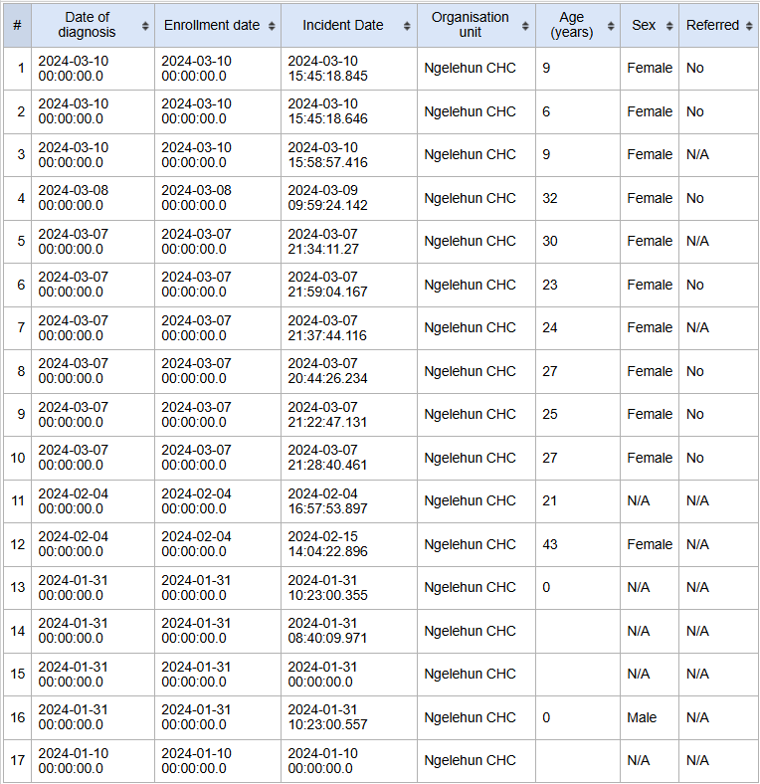
Patient Characteristics and Referral Patterns at Ngelehun CHC and Jembe CHC
(Last 12 Months)
Data Collection Steps:
Selected Ngelehun CHC and Jembe CHC as organization units.
Analyzed data from the Malaria Case Diagnosis, Treatment, and Investigation program.
Included key data elements: Referral status, Age (years) and Sex
Insights from Ngelehun CHC Data:
Referral Patterns:
Majority of patients were not referred ("No").
A large portion of entries were marked as "N/A" for referral status, reflecting incomplete data.
Patient Characteristics:
Age Distribution: Ages ranged from infants (0 years) to 43 years. Notable number of pediatric cases.
Gender Distribution: Majority of patients were female, though some entries lacked gender information ("N/A").
Limitations:
Incomplete documentation in Ngelehun CHC data, particularly in referral status and gender information.
Lack of data for Jembe CHC restricts the ability to conduct a full comparative analysis.

Slide 48
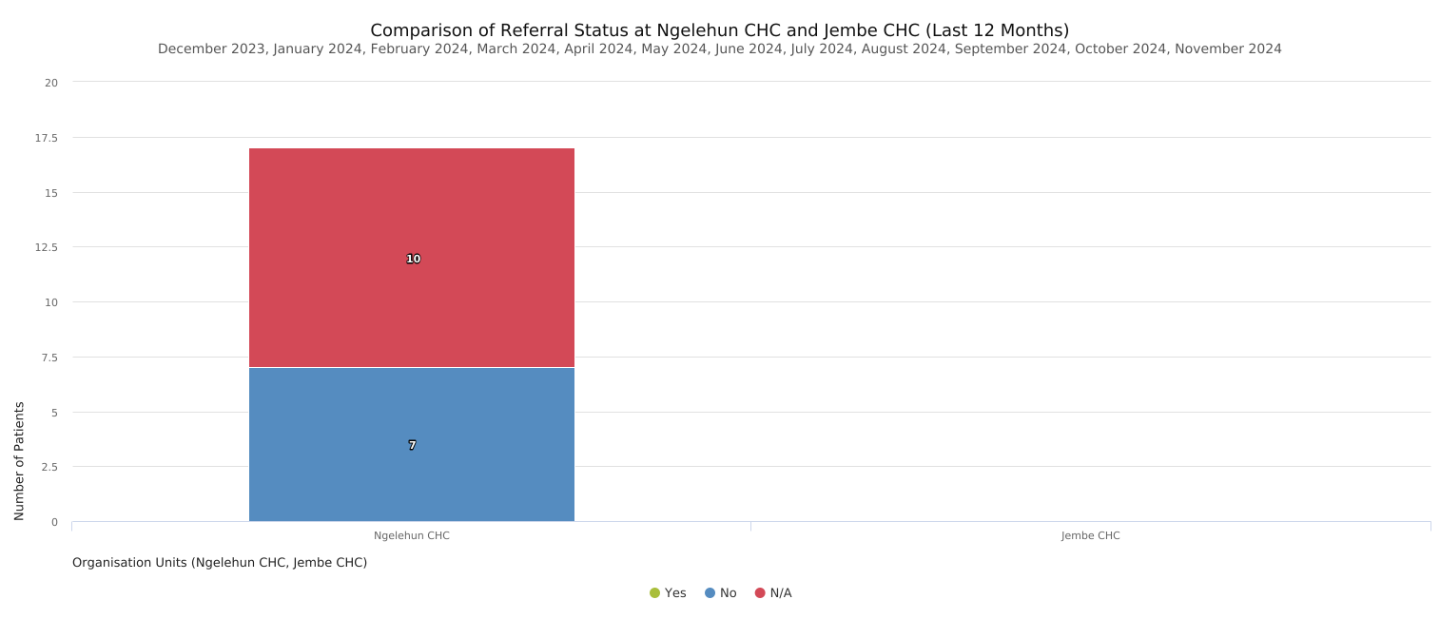

Interpretation: The stacked column chart shows that the majority of patient records from Ngelehun CHC had missing referral status marked as "N/A" (10 cases), followed by "No" referrals (7 cases). No "Yes" referrals were recorded for this period. Data from Jembe CHC is absent, preventing comparative analysis.

Slide 49
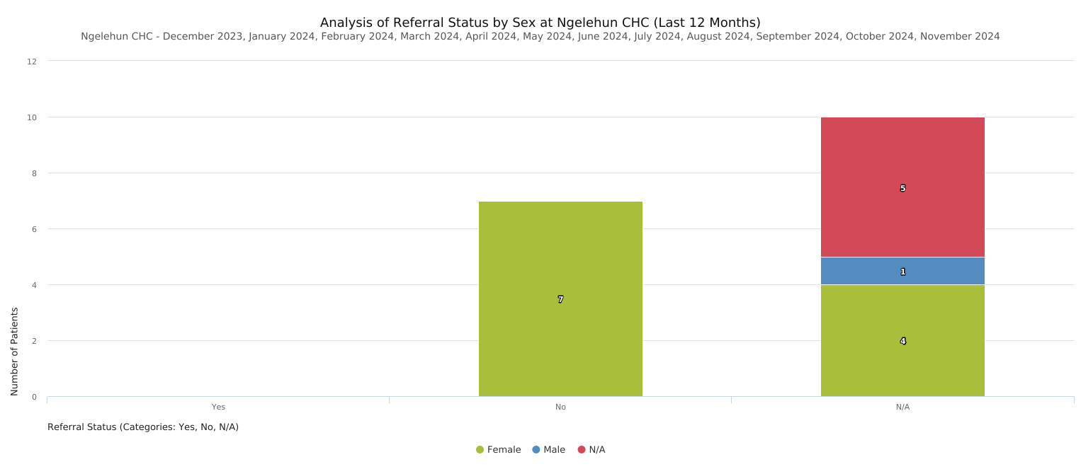
Interpretation: At Ngelehun CHC, most patients who were not referred are female (7 cases). Among patients with missing referral status ("N/A"), there is a mix of female (4 cases), male (1 case), and unspecified sex (5 cases). No patients of any sex were recorded as referred ("Yes") during this period.

Slide 50
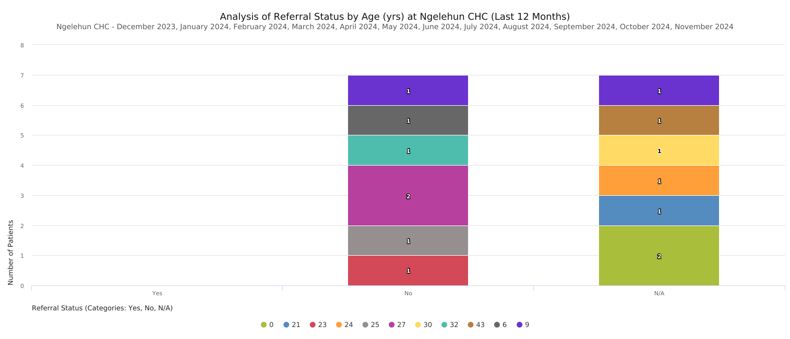
Interpretation: At Ngelehun CHC, most age groups have missing referral status marked as "N/A". Among the "No" referrals, patients are distributed across a range of ages, but no referrals ("Yes") are observed.

Slide 51

Patient Characteristics and Referral Patterns at Ngelehun CHC and Jembe CHC
(Nov 2023 – Nov 2024)
The data from Ngelehun CHC indicates that most patients were not referred, with several entries marked as "N/A", highlighting incomplete documentation.
Patients ranged from infants to 43 years, with a focus on pediatric cases, and the majority were female, though some gender data was missing.
Notably, one male infant (age 0) was explicitly referred, likely for specialized care.
The absence of data for Jembe CHC limits the ability to compare referral patterns and patient characteristics between the two facilities.

Slide 52


QUESTION 1b
12-Month Referral Forecast for Jembe CHC and Ngelehun CHC (2025)
Data Preparation and Modeling Steps:
Data Collection:
Extracted monthly referral data for Jembe CHC and Ngelehun CHC from DHIS2 (Jan 2023 – Dec 2024).
Data Preprocessing:
Addressed missing values in Ngelehun CHC using a 3-period Simple Moving Average.
Time Series Conversion:
Converted referral data into time series objects with monthly frequency.
Exploratory Analysis:
Decomposed time series into trends, seasonal, and random components. Split data into training (Jan 2023–Jun 2024) and validation (Jul 2024–Dec 2024) sets.
Model Fitting and Forecasting:
Tested multiple models: AUTO ARIMA, ETS, and SES Holt-Winters.
Selected SES Holt-Winters as the best model based on Mean Absolute Percentage Error (MAPE).
12-Month Forecast:
Generated point forecasts and confidence intervals for 2025.

Slide 53
Interpretation: The chart shows that Jembe CHC consistently recorded higher monthly referrals compared to Ngelehun CHC, except for January 2023 and January 2024, where Ngelehun CHC had significant spikes. This indicates a stark difference in referral trends between the two facilities.

Slide 54
Interpretation:
Jembe CHC:
The 12-month forecast for 2025 predicts seasonal variations in patient referrals.
Referrals range from 48 in January to 53 in December, with peaks in April (89) and July (101).
Seasonal patterns observed in historical data are effectively captured.
Ngelehun CHC:
Forecast predicts a spike in January (156 referrals), tapering to 99 referrals by December.
Highlights seasonal fluctuations, with high-demand periods in January and September.
Reflects trends observed in historical data, despite some variability.
Uses of the Forecast Models:
Resource Planning: Allocate staff, supplies, and budgets effectively for high-demand months like January and September (Ngelehun) and April and July (Jembe).
Seasonal Insights: Identify recurring patterns in referral trends to prepare for seasonal peaks and manage variability.
Jembe CHC - 12-Month Referral Forecast for 2025
Ngelehun CHC - 12-Month Referral Forecast for 2025

Slide 55
Considerations When Doing Predictive Modeling
Data Quality:
Missing data handled using a 3-period Simple Moving Average (SMA) to ensure completeness.
Feature Engineering:
Decomposed time series to identify seasonality, trends, and patterns for accurate modeling.
Model Selection:
Tested multiple models (Auto ARIMA, ETS, SES Holt-Winters) and selected SES Holt-Winters for best performance and lowest MAPE (Jembe: 18.38%, Ngelehun: 45.77%).
Model Evaluation:
Evaluated models using MAPE, ensuring they captured seasonal variations effectively.
Seasonality and Trends:
SES Holt-Winters explicitly addressed seasonality and trends critical for time series forecasting.
Uncertainty and Confidence:
Included confidence intervals (80% and 95%) to quantify prediction variability and guide planning.
Notebook Link:
https://colab.research.google.com/drive/1-XC5MgoX47xNJPCBoLO5BA72AkM3aal_?usp=sharing

Slide 56


Sourcing of Data and Data preparation for Question 4 from Section 5-
We created a pivot table using the case count in Western area district(It is the one with highest average cases of Diarrhea) and downloaded it in the form of CSV file.
Imported that CSV file into colab to do our forecasting, there were no missing data or outliers, there was only one outlier in the Rural western area which we felt was not so significant.
Decomposed the time series and found that there is weak seasonality in the data.
We forecasted the data for next year using Auto- Arima, ETS and Holt Winters, out of all these we found that Auto- Arima was the better performing model. This Auto- Arima used Non seasonal Arima with p,d,q being 0,0,0.
We chose MAPE because it provides an intuitive, percentage-based accuracy measure.
The data has weak seasonality, no outliers, and no missing values, making MAPE reliable.
With only 2 years of data, MAPE is simple to interpret for short time series.

Slide 57

Why we selected Auto ARIMA
We selected Auto ARIMA because it provided the lowest MAPE among all tested models for our dataset.
Auto ARIMA efficiently handled the 2 years of monthly data, identifying weak seasonality and non-stationarity.
It eliminated the need for manual parameter tuning (p,d,qp, d, qp,d,q), ensuring optimal performance for both Freetown and Rural Western Area.
The absence of outliers and missing values in the data allowed Auto ARIMA to model the trends and patterns accurately.
Its adaptability to short time series like ours ensured reliable forecasts without overfitting.

Slide 58
ANC-3 Coverage and Delivery Rates Analysis Methods
Methods
Data visualizations created for ANC-3 coverage and PHU delivery rates using line charts and choropleth maps.
Used spatial analysis to compare delivery rates and complicated deliveries across regions and facilities.
Pros:
Highlighted patterns and correlations, such as peaks in ANC-3 coverage and delivery rates in specific months and locations.
Maps provided spatial insights into accessibility and facility-level challenges.
Helped identify facilities with high delivery rates or service gaps.
Cons:
Imbalanced data made it difficult to capture trends for facilities with missing data (e.g., Bonthe Hospital).
Static methods lack deeper insights into temporal trends and population-specific issues.
Delivery rates and complications are influenced by external factors not captured in the data, such as patient behavior or transport challenges.
Biases and Mitigation Strategies:
Bias: Lack of ANC-3 data at some facilities creates gaps in spatial analysis.
Mitigation: Collect more comprehensive data from underserved areas.
Bias: Neutral delivery trends might mask high-risk deliveries on the mainland.
Mitigation: Analyze data with specific population subgroups (e.g., high-risk pregnancies).
Bias: Seasonal or regional trends may skew delivery data.
Mitigation: Use dynamic temporal models to analyze seasonal effects.

Slide 59
Topic and Sentiment Analysis—Methods
Sentiment Analysis:
Used TextBlob to assign polarity scores, classifying text as Positive, Neutral, or Negative.
Most data was Neutral due to the scientific nature of the topics, limiting sentiment variability.
Imbalanced data made calculating metrics like F1-Score difficult and skewed overall results.
Future improvements include using domain-specific models and balanced datasets to handle such biases.
Topic Modeling:
Applied Latent Dirichlet Allocation (LDA) to extract scientific themes from the corpus.
Optimal topic count was selected using coherence scores to ensure meaningful topic separation.
Generated keyword tables and visual maps to interpret themes, such as healthcare delivery and accessibility.
Preprocessing, including stop word and punctuation removal, improved clarity

